Slide 1
VICAN: Relationship between socio-economic factors, geographic inequalities and breast cancer sequelae
Audrey Bergès, Inès Multrier, Swann Chelly, Ludovic Pailloux

Slide 2
Summary
Analysis of VICAN database
Departments’ clustering
t-SNE clustering
UMAP clustering
Comparison of both clusterings
Socio-economic analysis of clusterings
Sequelae analysis within clusterings

Slide 3
I - Analysis of the VICAN database

Slide 4
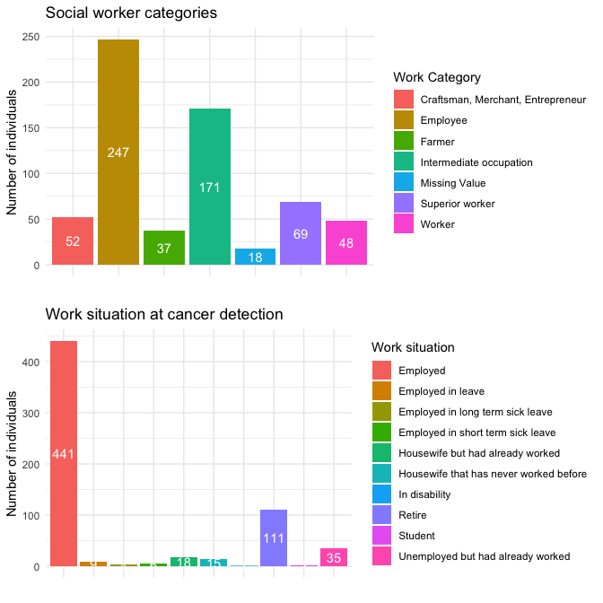
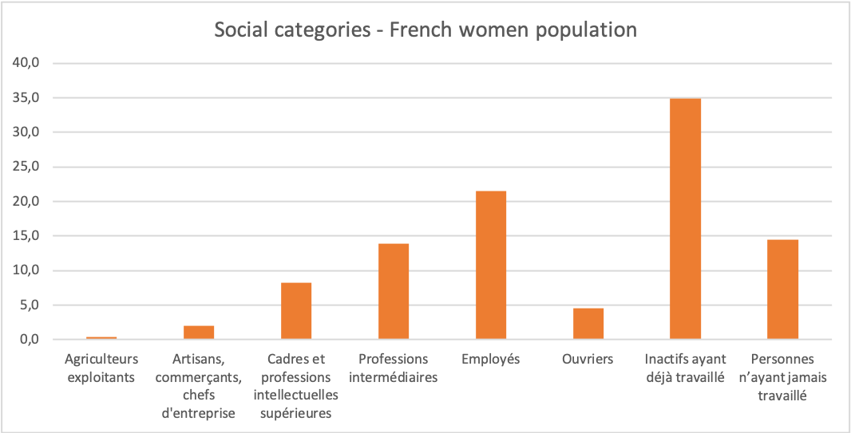
Ordinary women...

Slide 5
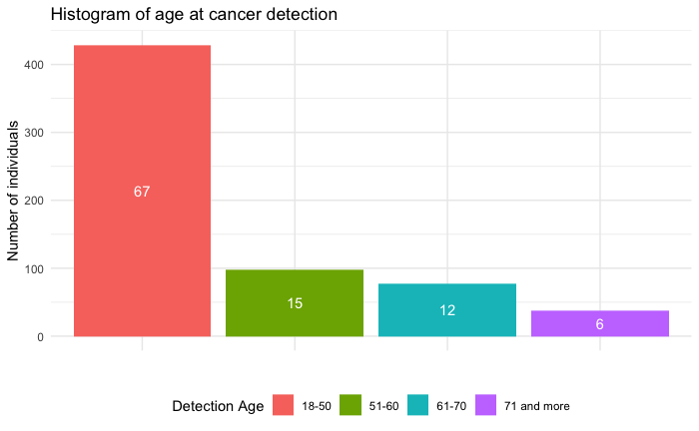
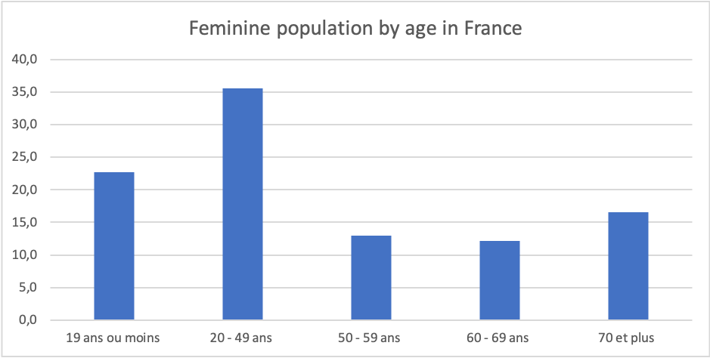
… Whose age distribution approaches that of the national population...

Slide 6
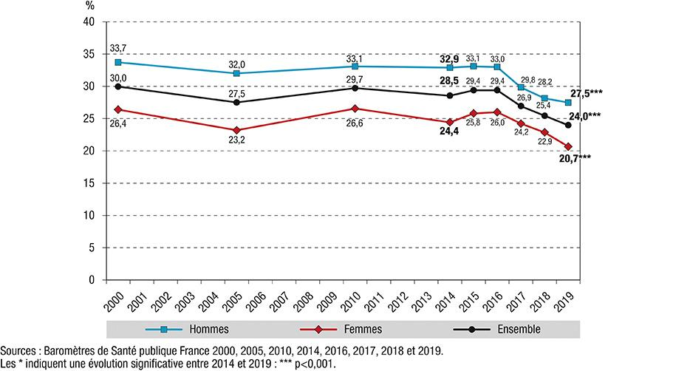
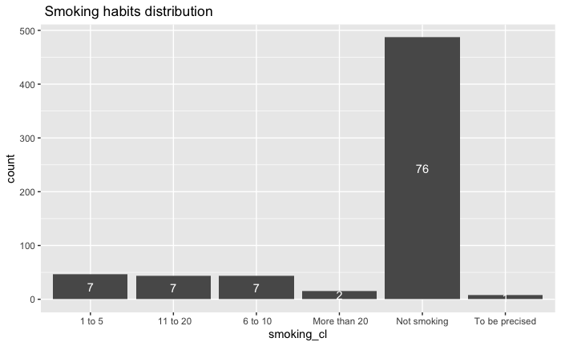
… Who do not smoke more than the French average...

Slide 7
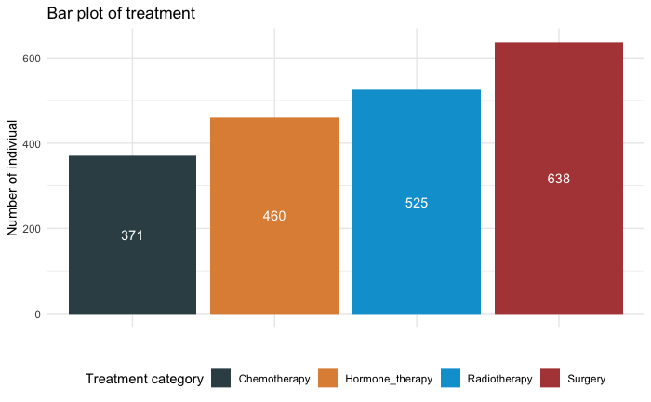
… Who have been diagnosed with breast cancer...

Slide 8
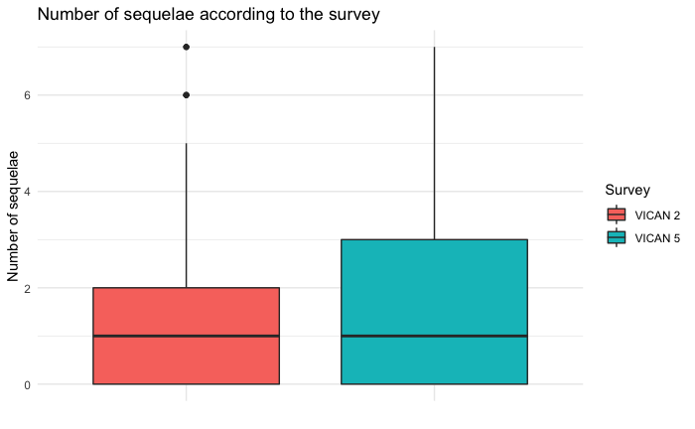
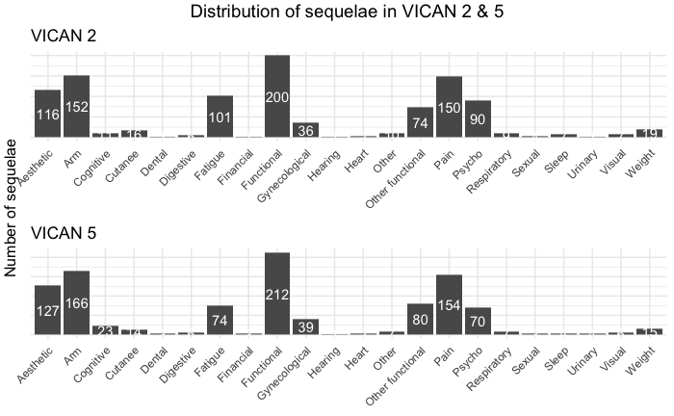
… And who suffer from sequelae (for most of them).

Slide 9
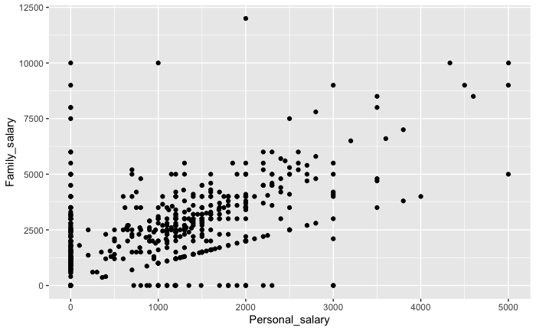
Personal and family salary analysis

Slide 10
II - Departments’ clustering

Slide 11
II.a. - t-SNE clustering

Slide 12
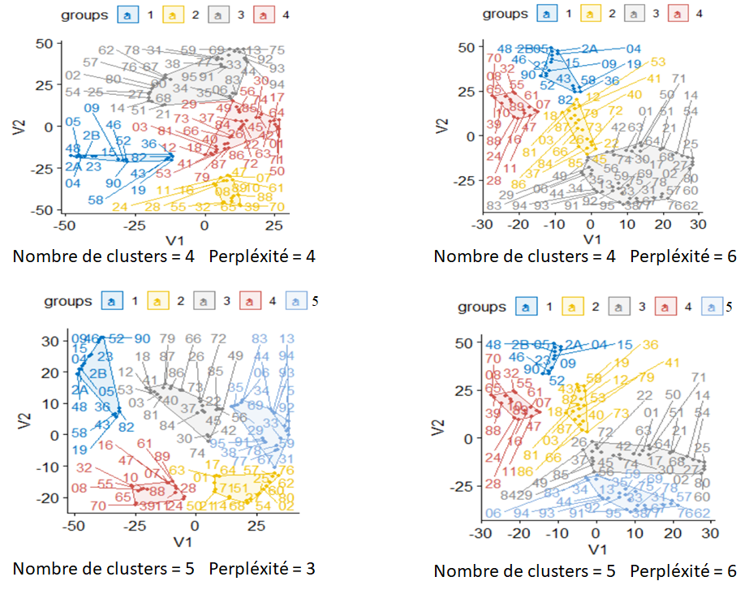
t-SNE clustering

Slide 13
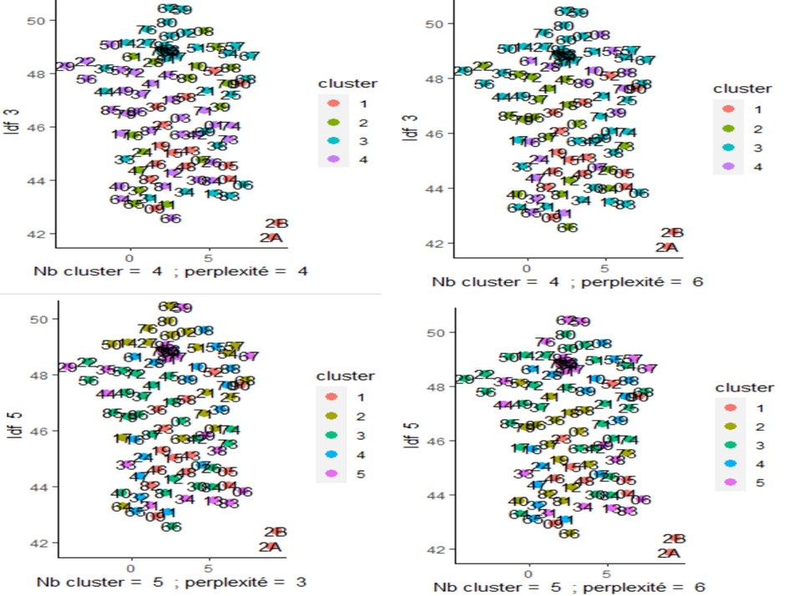
t-SNE

Slide 14
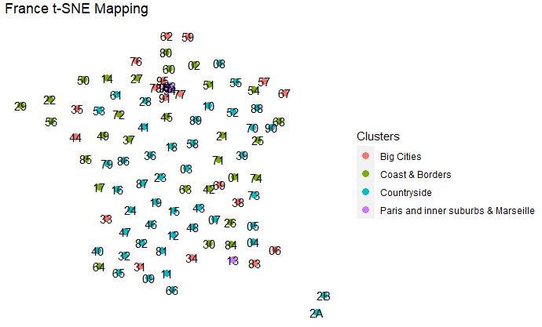
t-SNE clustering

Slide 15
II.b. - UMAP clustering

Slide 16
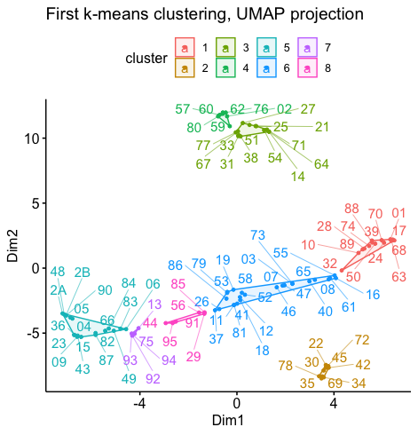
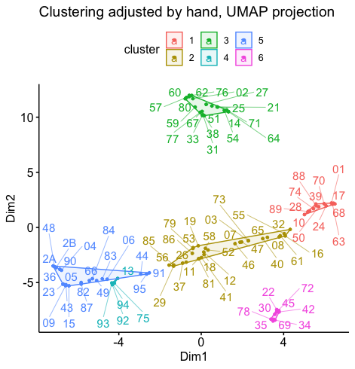
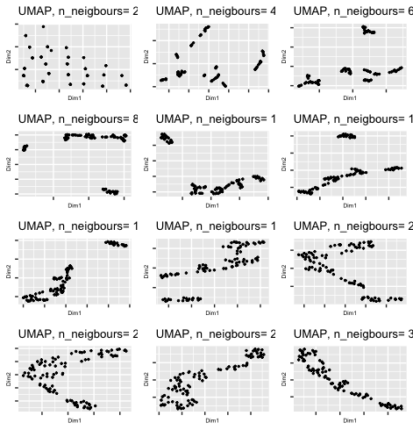
UMAP clustering
UMAP clustering

Slide 17
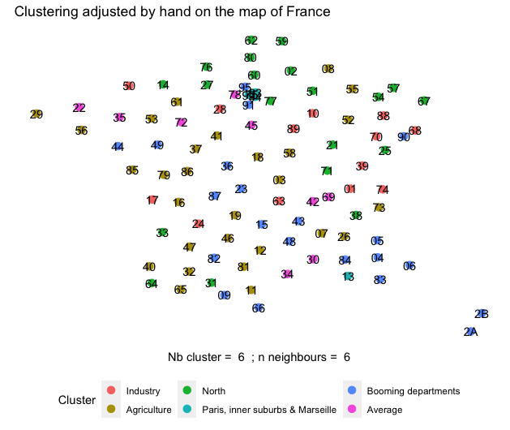
UMAP clustering

Slide 18
II.c. - Clustering comparison

Slide 19
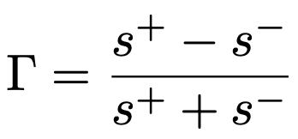

Clustering comparison - Indexes
3 indexes:
Pearsongamma
Sindex (separation index)
Dunn

Slide 20

Clustering comparison - Mistake
Mistake in running the code: we ran the wrong database
Clustering based on tSNE: preprocessed data dividing each socio-economic feature by the averaged population within each department
Clustering based on UMAP: preprocessed data NOT dividing each socio-economic feature by the averaged population within each department
⇒ The comparison of indexes is not relevant
Notes:
Dire en ccl de l’analyse socio eco des clustering que finalement la population etait une donnee importante comme le clustering UMAP est meilleur

Slide 21
III - Socio-economic analysis of clusters

Slide 22

Clustering comparison
Clusterings comparison

Slide 23
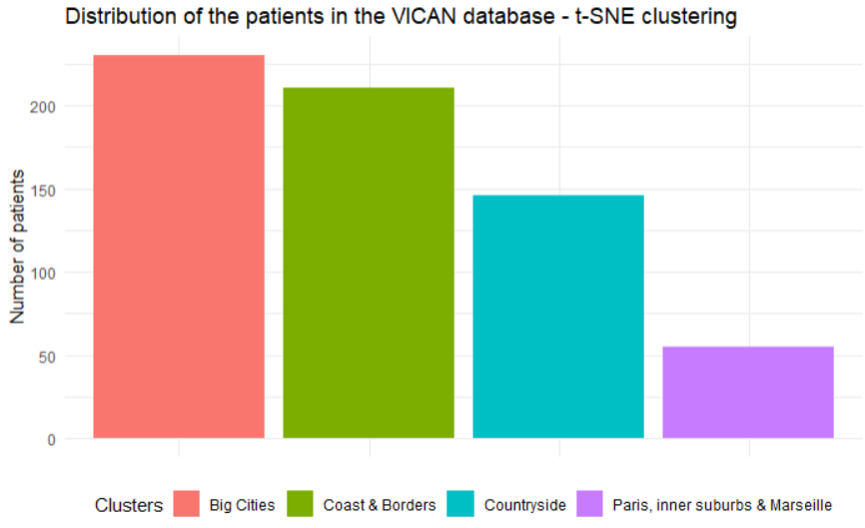
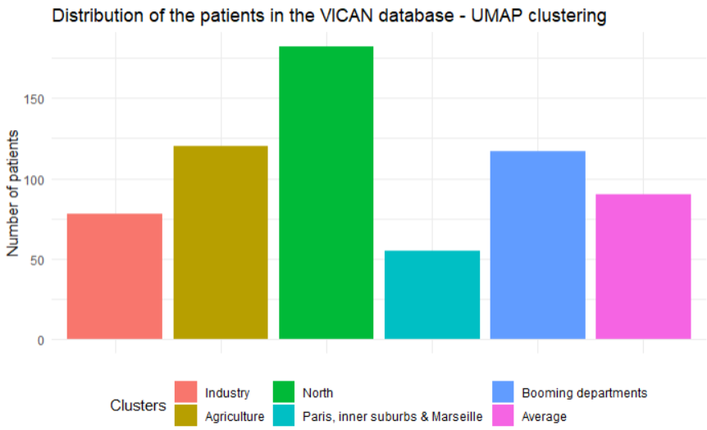
Clustering socio-economic survey
Notes:
Clustering cohérent concernant la population dans le jeu de donnée socio ?

Slide 24
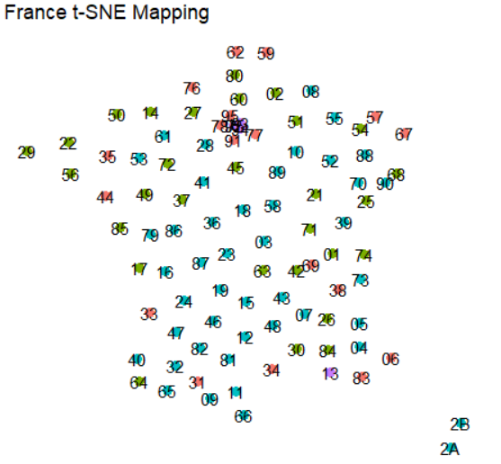
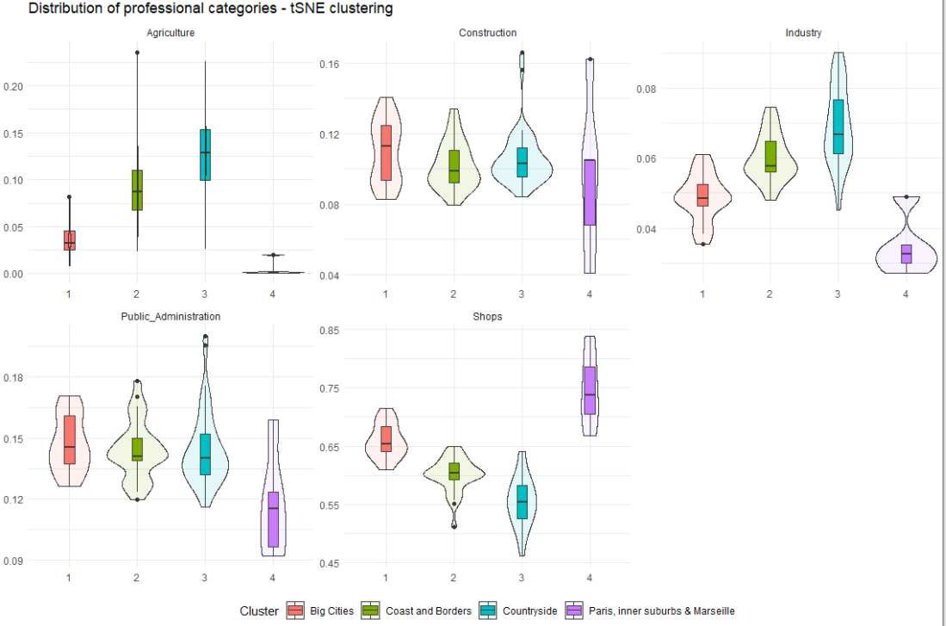
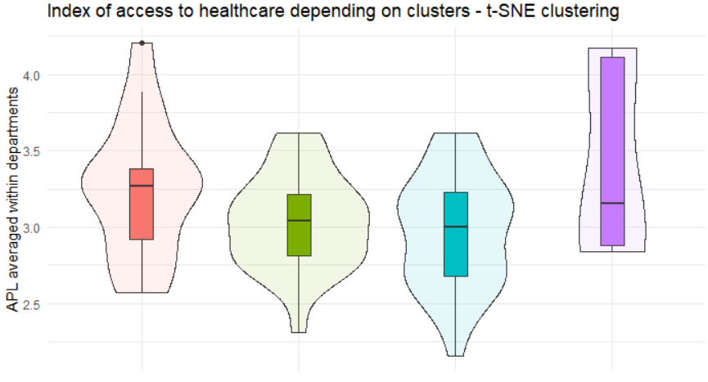
Clustering socio-economic survey - t-SNE
Notes:
Clustering cohérent concernant la population dans le jeu de donnée socio ?

Slide 25
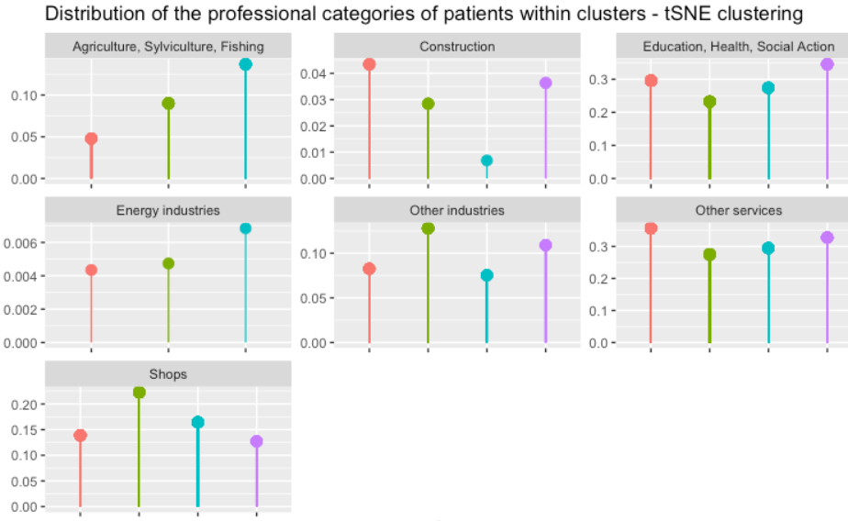
Clustering socio-economic survey - t-SNE

Slide 26
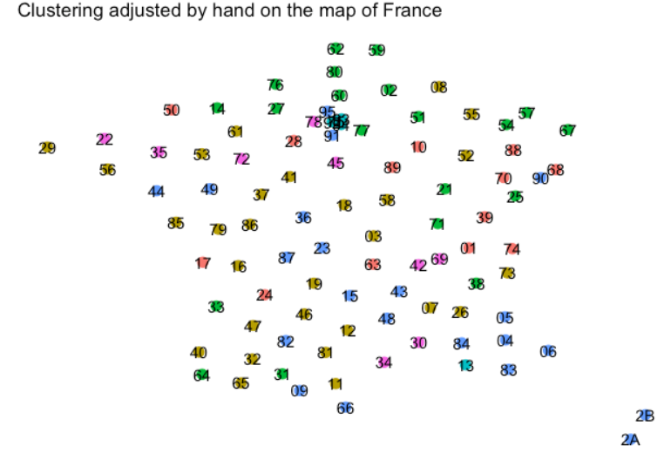
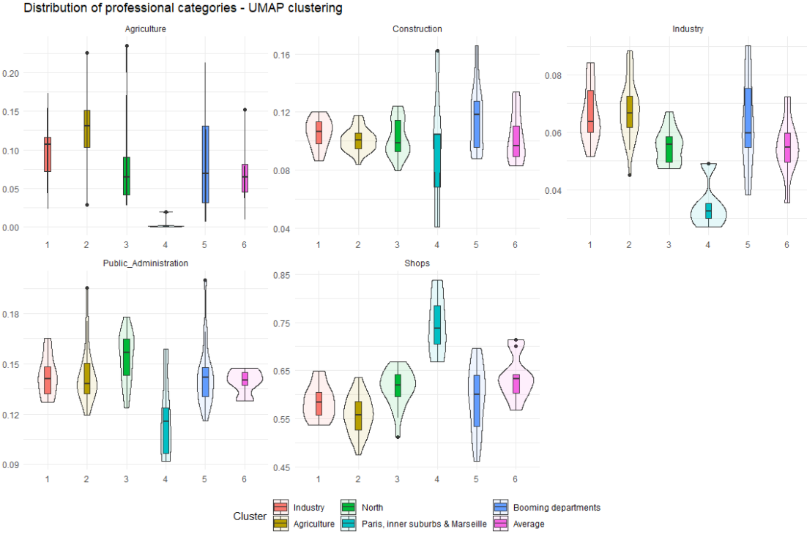
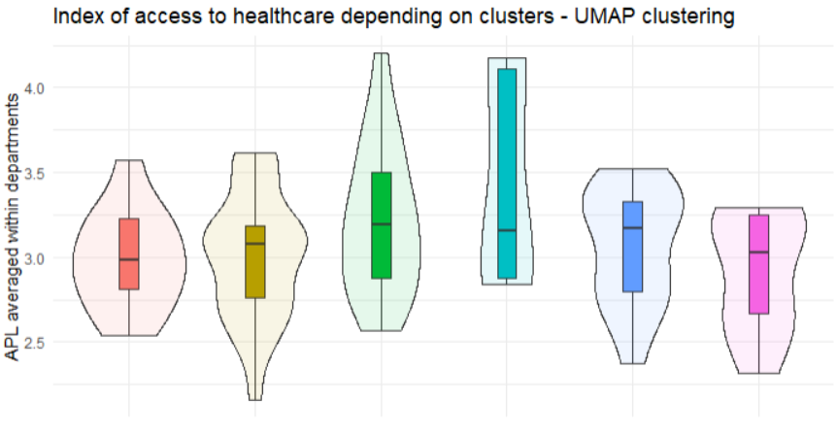
Clustering socio-economic survey - UMAP
Notes:
Clustering cohérent concernant la population dans le jeu de donnée socio ?

Slide 27
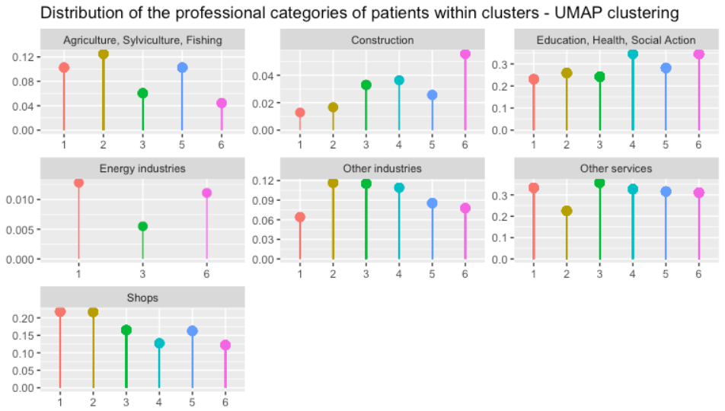
Clustering socio-economic survey - UMAP
Notes:
Clustering cohérent concernant la population dans le jeu de donnée socio ?

Slide 28
IV - Sequelae analysis inside clusters

Slide 29
IV.a. - Sequelae analysis: t-SNE clustering

Slide 30
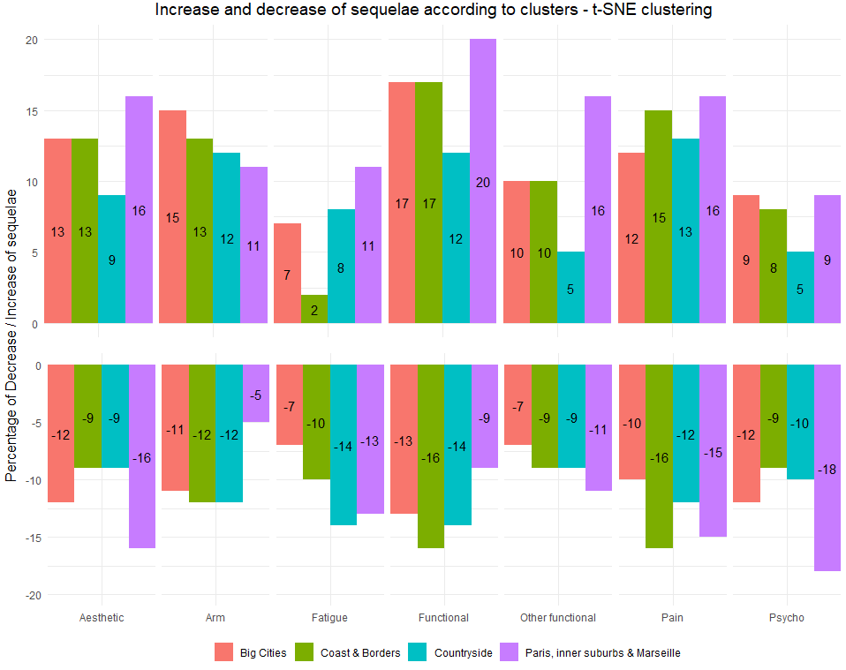
Evolution of sequelae in t-SNE clustering

Slide 31
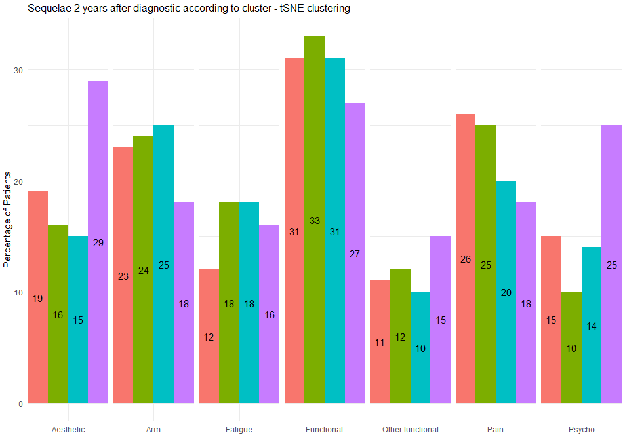
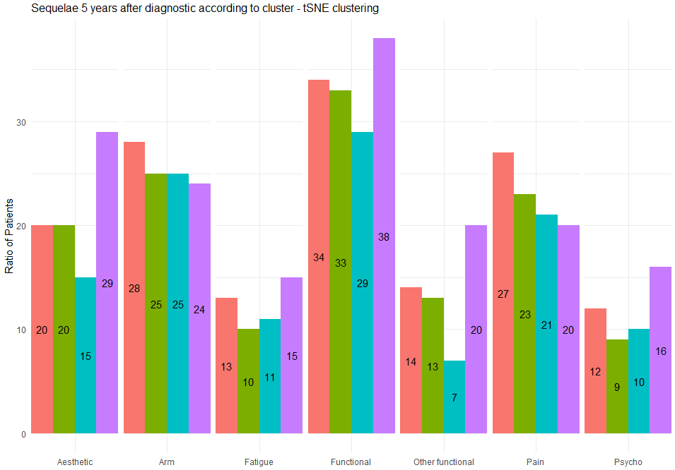
Sequelae by cluster - t-SNE clustering

Slide 32
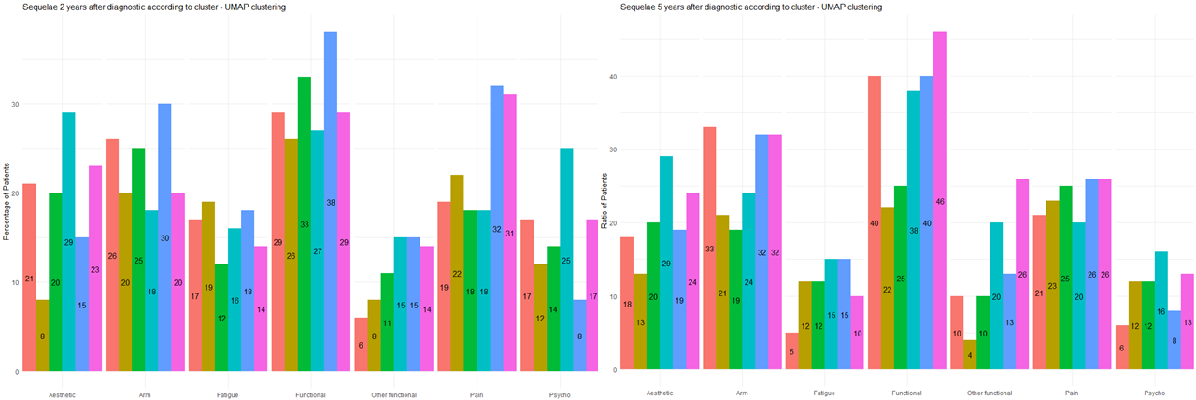

Sequelae by cluster - UMAP clustering

Slide 33
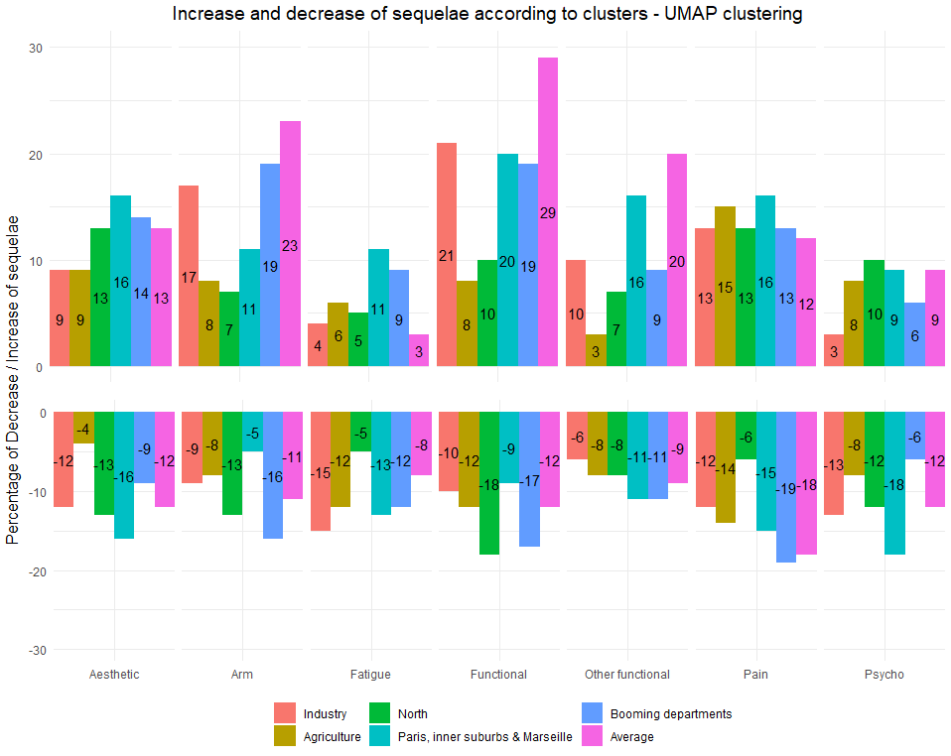
Evolution of sequelae in UMAP clustering

Slide 34
Discussion
Important statistical biases
Learning about french departments

Slide 35

Conclusion
North: good recovery over time
Paris, its suburbs and Marseille: important sequelae concerning aesthetics and psychology

